Slide 1


DC Blocking Capacitors
A Simplified Approach To Choosing a DC Blocking Capacitor
John Rogers, October 2026
Space Passive Component Days

Slide 2
Topics
Basic functionality and purpose of the dc block / coupling capacitor
The benefits of using them
How a capacitor’s characteristics effect signal integrity
Voltage and frequency considerations for choosing them
A simplified approach to select the right part number.
Automotive and Hi Reliability products

Slide 3
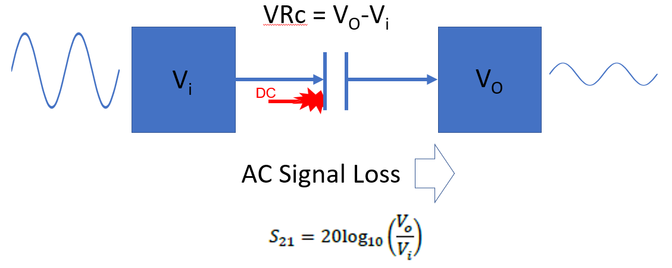
DC Blocking Capacitor Basics
DC Block plays an important role in various applications
Used in Audio Amplifiers, RF Systems, Radios, High speed Data Lines
Placed in series between RF stages that often operate at different bias voltages
Isolates DC bias voltage levels between the stages
Also known as a Coupling Capacitor as it is intended to pass AC signals
Proper capacitor selection prevents excessive signal loss over a frequency band.

Slide 4

Blocking Capacitor Benefits
  Blocking Caps isolate sections of a circuits that operate at different DC voltages
  Protects delicate RF components in Communication equipment, High Reliability MIL radios, telecom modems, routers, WiFi, IoT etc.
  Protects RF receivers from harmful DC power levels
  Improves signal integrity
DC Voltage Considerations
A key specifications that needs to be considered is the maximum DC voltage rating
  This is the difference between the DC voltages of the stages plus Vp of the AC component.
V_{R} > (Vo – Vi) + V_{PAC}
Vi
Vo
DC

Slide 5


Coupling Capacitor Basics – What about the signal?
Another purpose of the DC Blocking Capacitor is to allow AC signals to pass
The wrong capacitor will cause signal attenuation in the desired frequency range
This attenuation attributed to the capacitor is known as series insertion loss or S21.
Insertion loss is typically expressed in magnitude dB and determined by the measure of the forward transmission coefficient S21
where ,
Increasingly negative values of S21 magnitude correlates to greater signal loss.
  An S21 of -0.5 dB represents a 10 % power loss.
  An S21 of -3.0 dB would result in a 50 % power loss.
AC
Signal loss
Cap

Slide 6
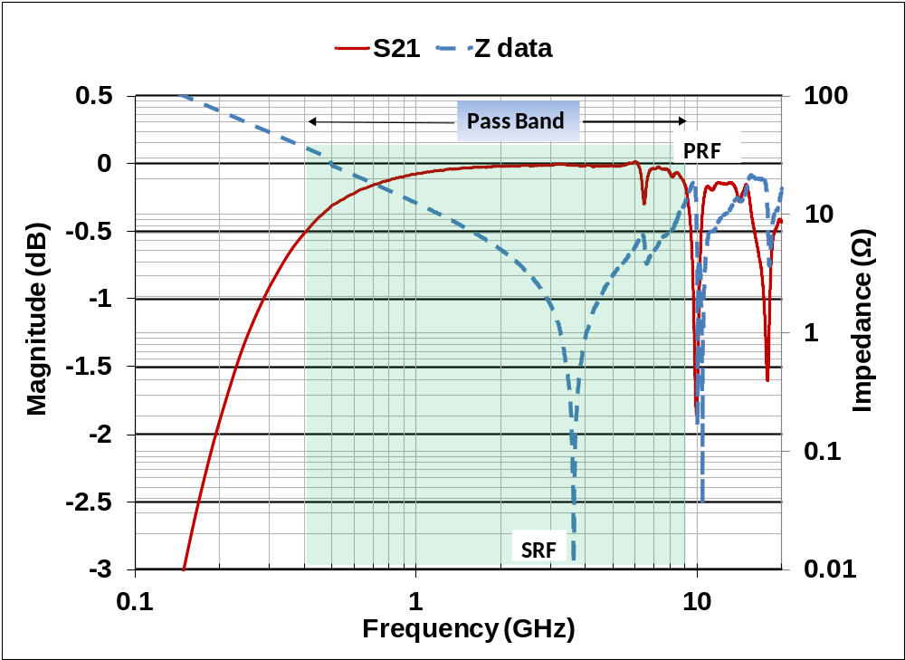
Influence of Complex Impedance on S21
S21 attenuation is proportional to the capacitor’s complex impedance. The higher the impedance, the higher the loss.
A capacitor having sufficiently low impedance throughout the desired frequency band will have a low S₂₁ and provide good signal coupling.
Parasitic behavior at higher frequencies cause erratic resonances which influence RF signal loss.
Knowing the frequency at which these parasitic resonances occur can identify the limits of that capacitors pass band.

Slide 7

A Simplified Approach to Choosing a DC Blocking Capacitor
All caps block DC but not all capacitors couple signals efficiently in the desired band
Need Voltage Rating, Frequency Band, Case Size
Iterative testing and measuring performance (requires timely rework)
Just get a broadband capacitor? (specialty cap, more costly)
Calculate capacitance from Fco and system impedance (what about Parasitic effect)
Simplified Approach:
Select from a series of capacitors already characterized for Common frequency bands
The characteristics are known, S21 < 0.5dB and S2P files available

Slide 8
A Simplified Approach to Selecting a DC Blocking Capacitor
STEP 1
Select frequency band
(0.5 db S₂₁)
HF, VHF, UHF, L, S, C X, Ku
STEP 2
Select rated maximum voltage available
25, 50, 100, 500
STEP 3
Choose available
case size
0402, 0603, 0805, 1210
STEP 4
Select component
grade
Standard, Automotive, High Reliability
Notes:
Application focus; Choose from already characterized parts

Slide 9
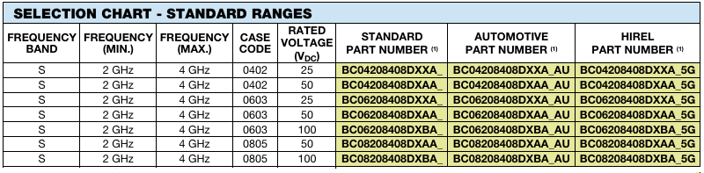
Selecting from DC Block Data Sheet
Example:
Application requirements of S band with 50V, 0402, for high reliability application
Hi Rel Part Number
BC04208408DXAA_5G

Slide 10
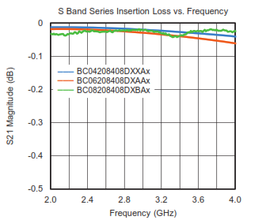
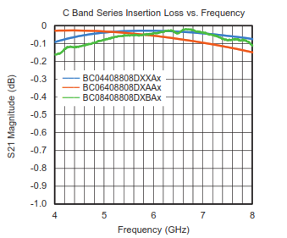
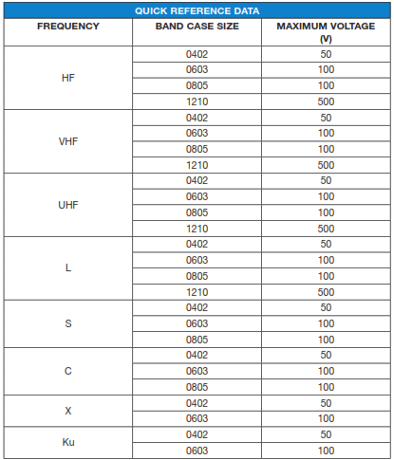
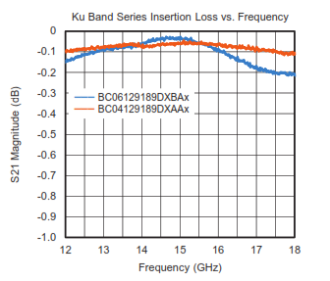
Selection of Pre-Characterized Frequency Bands
Custom DC Block part number can be established for application specific requirements.

Slide 11
Beyond Commercial Grade – Automotive
Often, an application will require more than a commercial rating
An automotive part might be a solution
Vishay has AEC-Q200 Qualified Capacitors Manufactured in IATF16949 Facility
Automotive Grade – provides higher reliability compliance directives
  Robust Design Policy
  Safe Launch Program
  IATF16949 Facility
  Maverick Lot Program
  Reliability Monitoring
  Error Proofing
  Lessons Learned / Look Across

Slide 12
Beyond Commercial and Automotive Grade – Hi-Rel
Beyond what an automotive grade part can offer, an application may require more.
Hi-Rel part advantages:
Qualified per the requirements of MIL-PRF-55681
Manufactured on a MIL-PRF-55681 qualified product line
Reliability maintenance testing to verify consistent quality
5G suffix = 100% voltage conditioning/screening
C of C report to confirm compliance

Slide 13
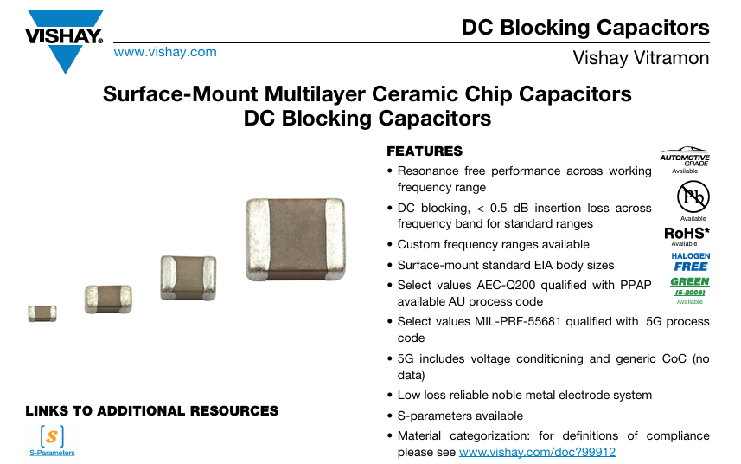
Links to S-parameters From Data Sheet

Slide 14
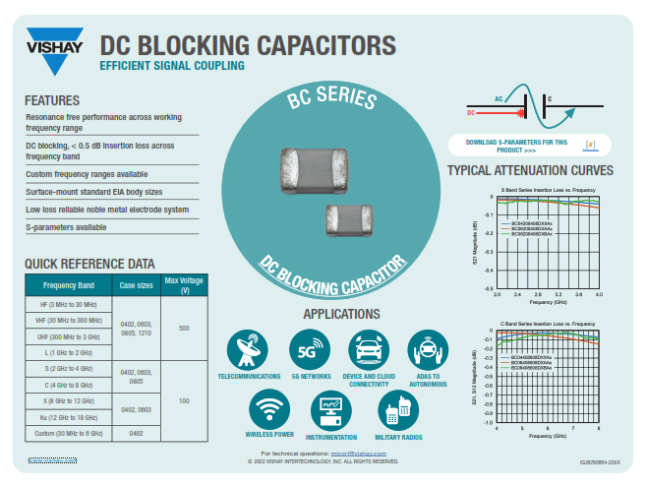
DC Blocking Capacitors
Specific parts for key bands
VHF, UHF, L, S, C, X, Ku
Custom bands available
Pre-Characterized
Resonant-free blocking
<0.5dB S21 across band
Rated voltages
From 25V to 500V
Beyond Commercial
Automotive
High Reliability
dcblockingcaps.pdf (vishay.com)

Slide 15
Thank You
Questions?
For technical questions, contact: mlcc@vishay.com
John.Rogers@Vishay.com

